Slide 1
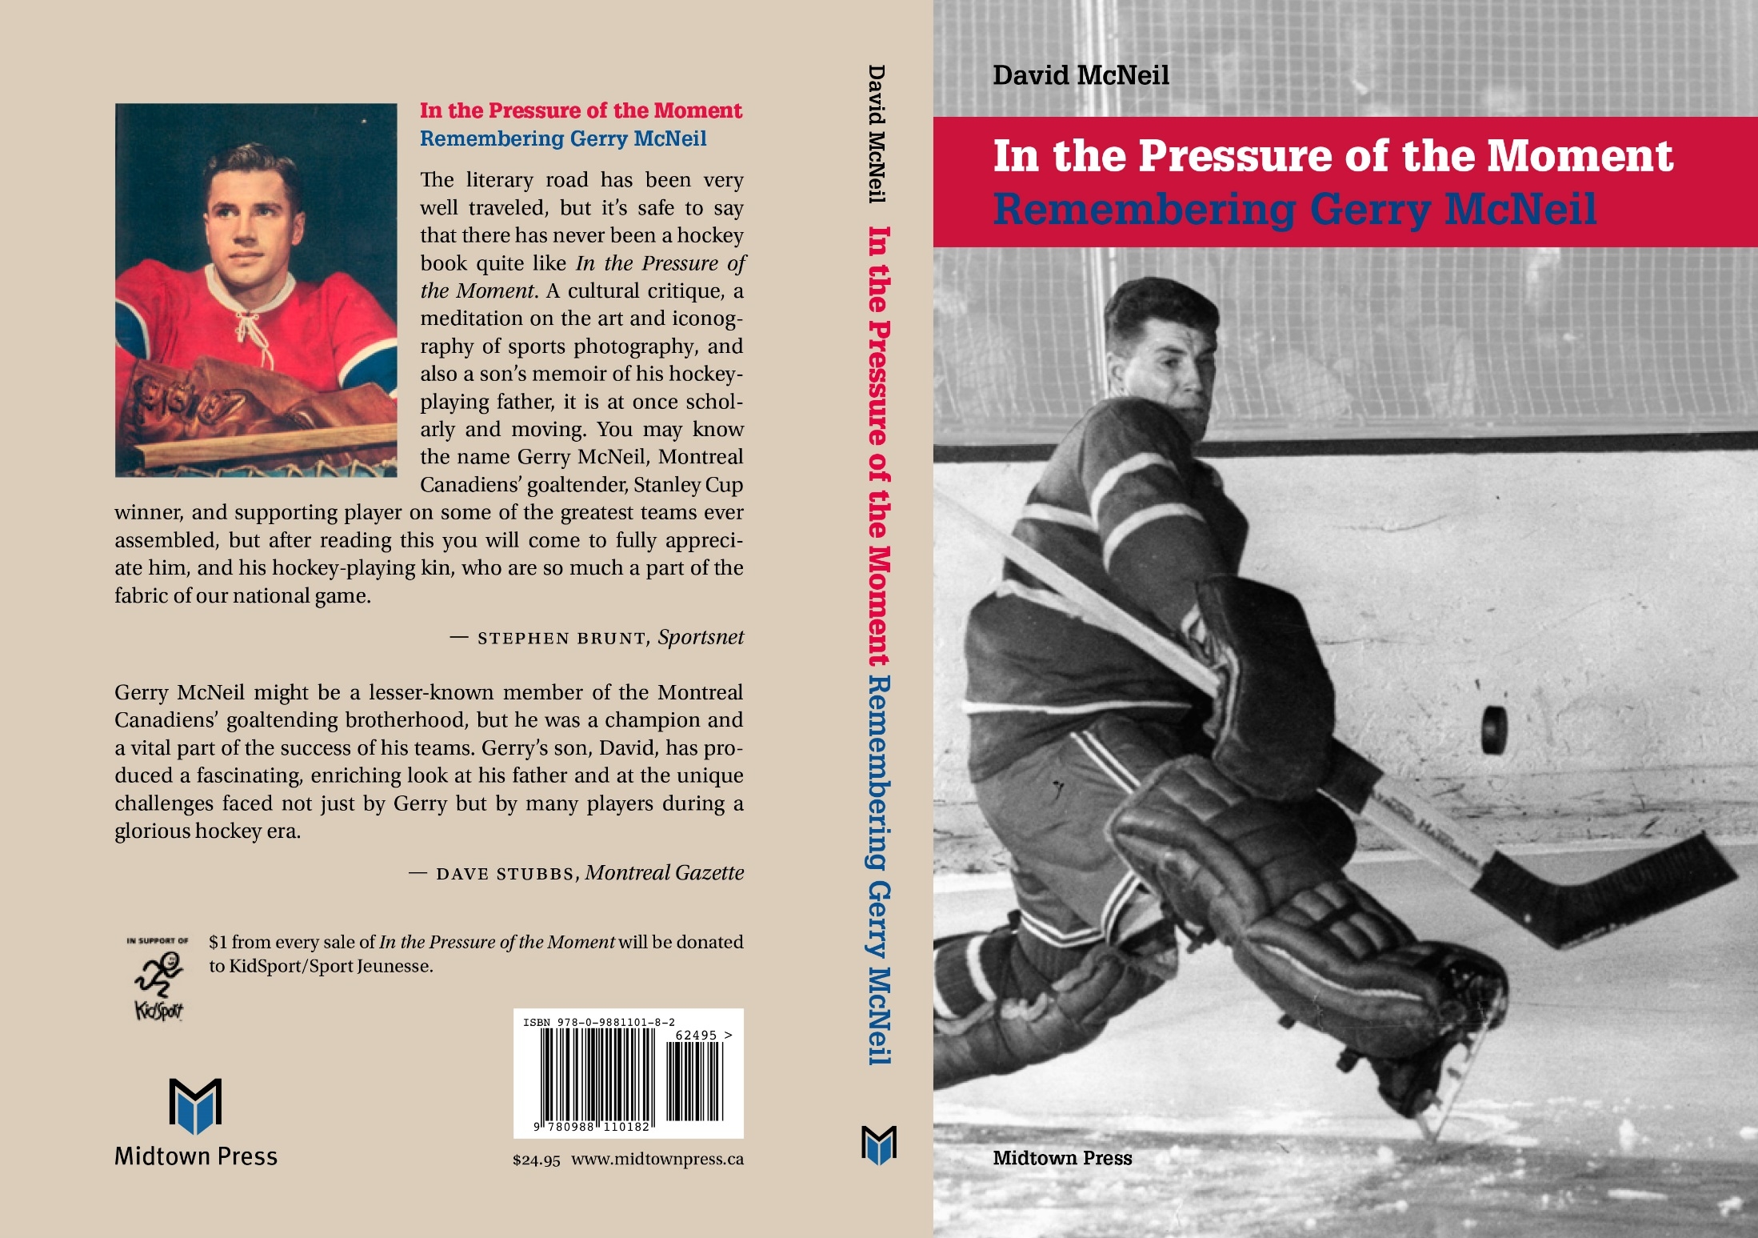


Slide 2
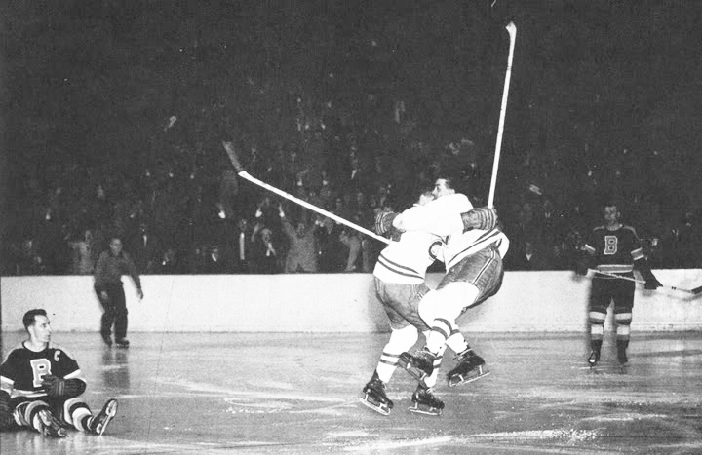
When one opportunity is lost, another may be born. Photo: Roger Saint-Jean.

Slide 3
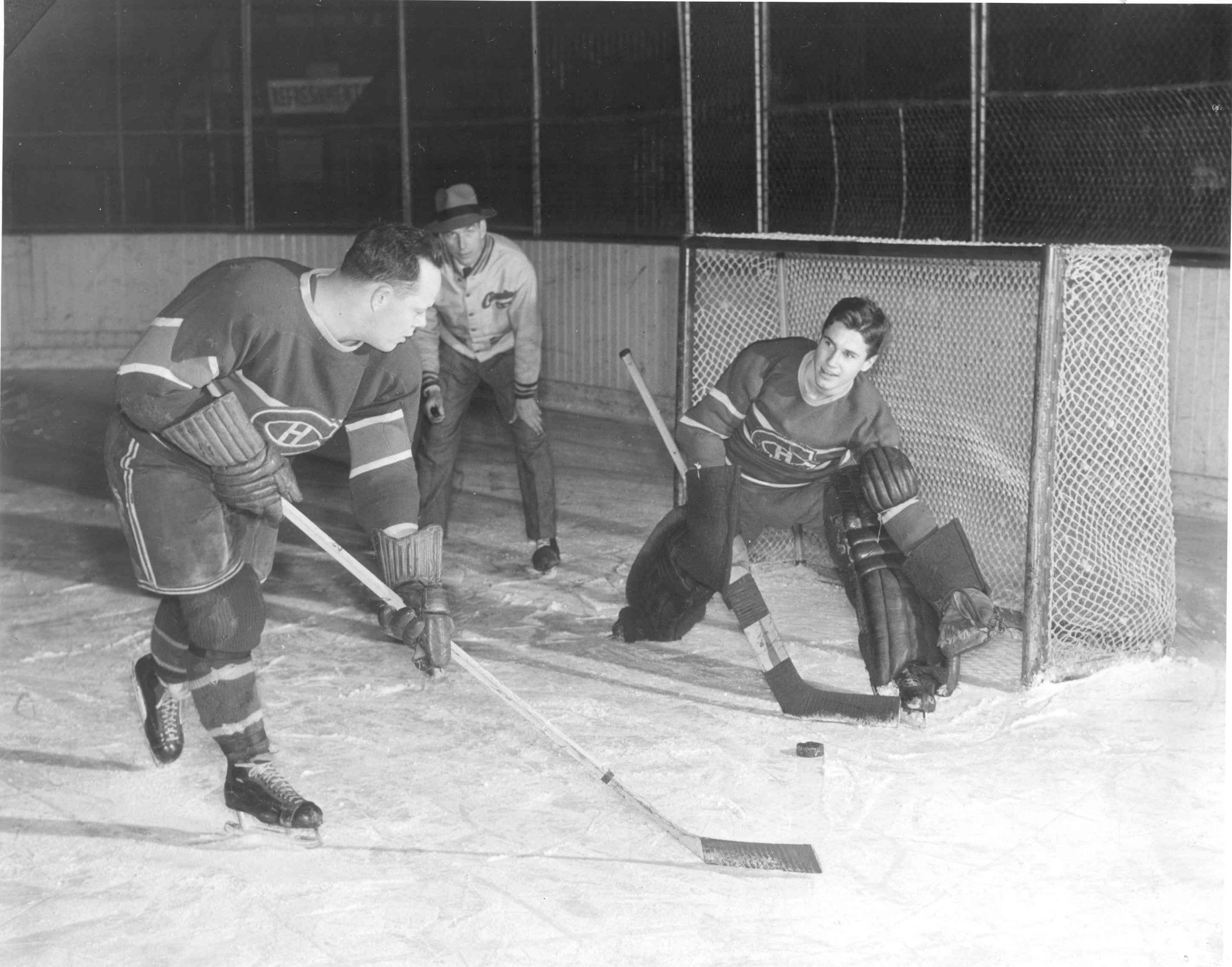
A teen at the Habs’ training camp.

Slide 4
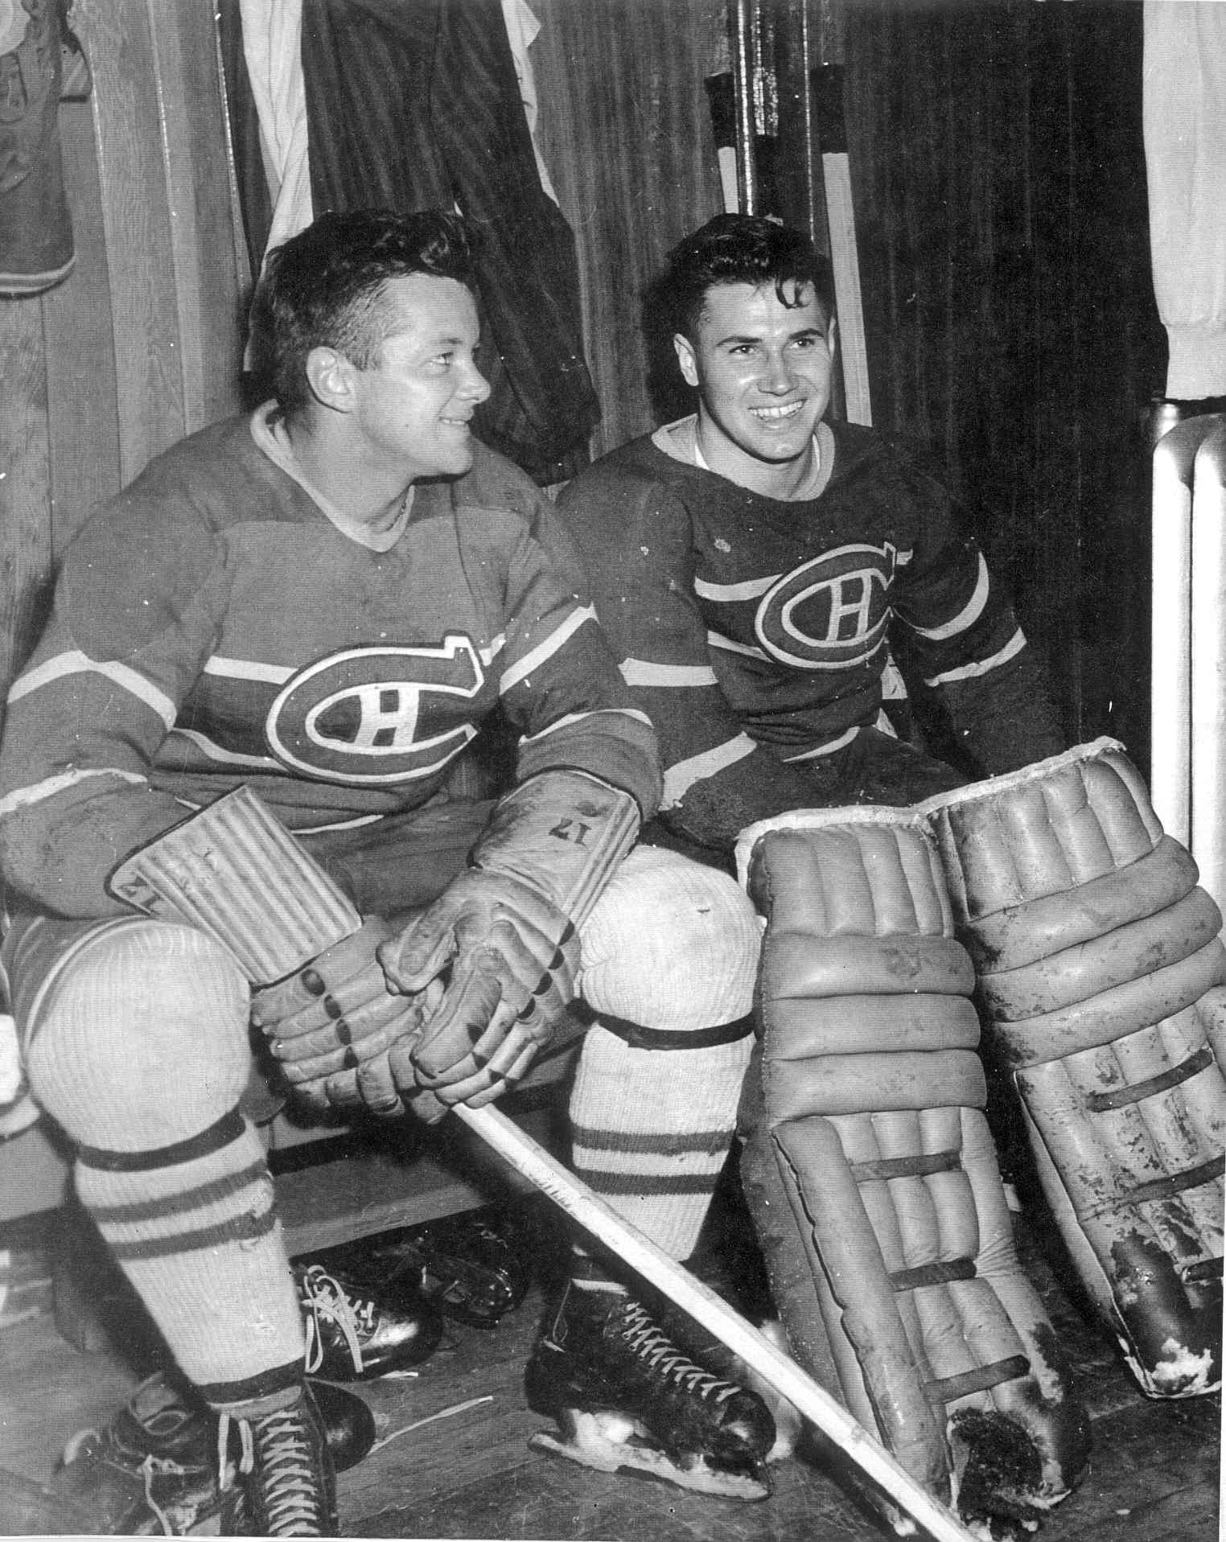
Gerry and Doug – so young and so much ahead.

Slide 5
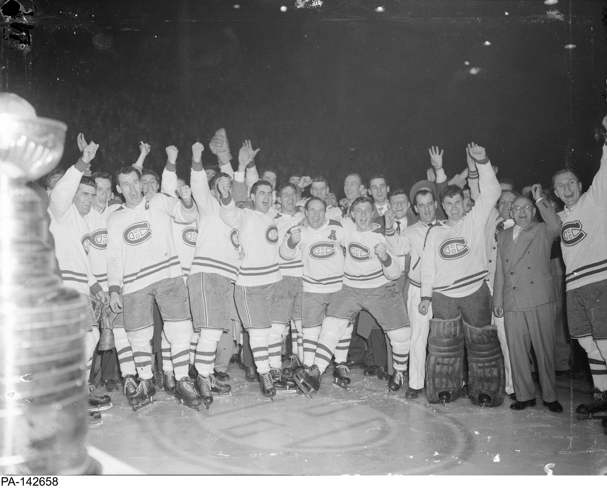
Only the seventh Stanley Cup for Montreal (1953), but on the eve of many more.

Slide 6
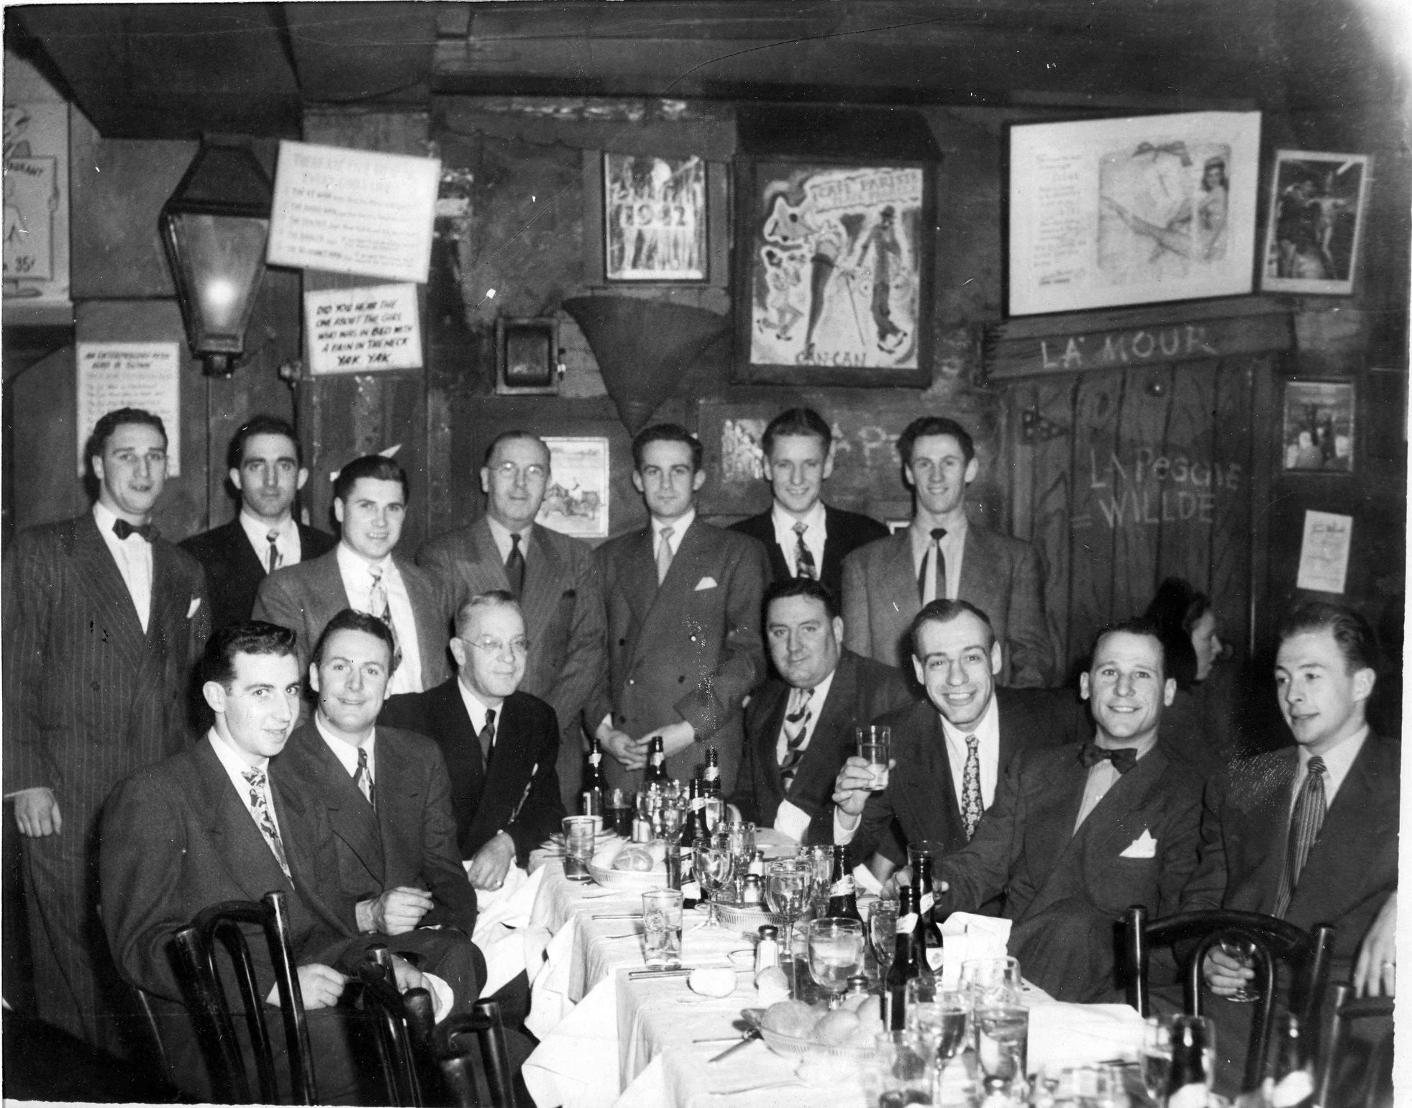
The Montreal Royals at Leon and Eddie’s in New York.

Slide 7
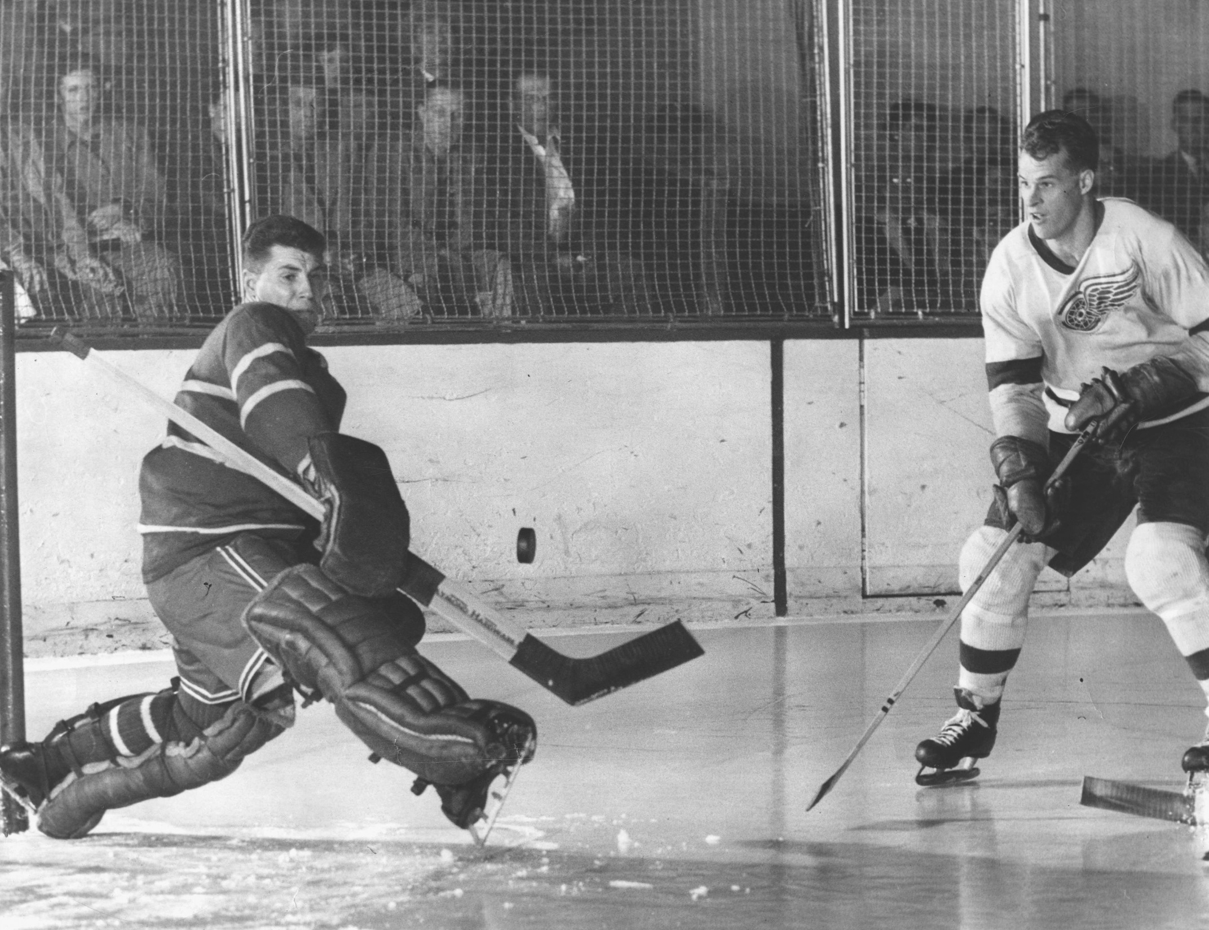

Slide 8
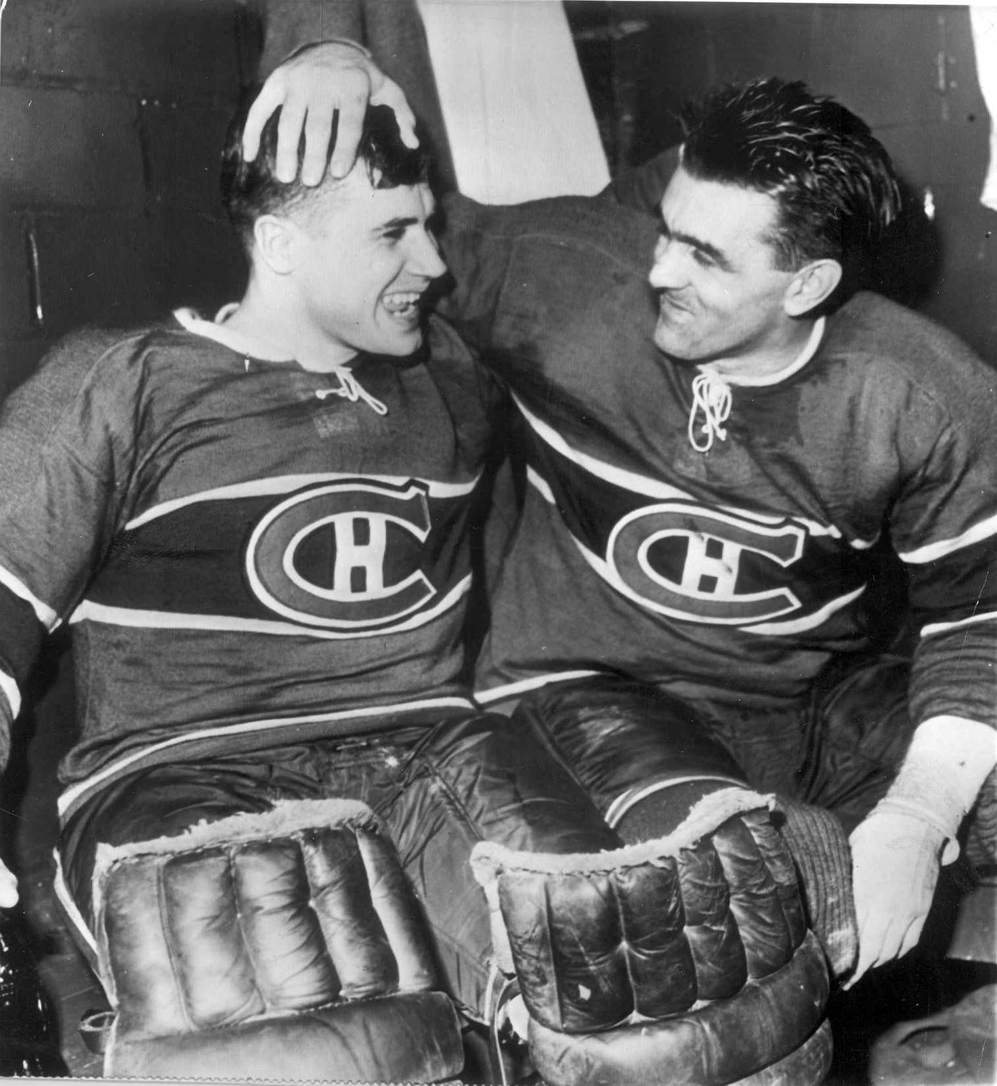
They would go on to win and lose Stanley Cups together, but here a special moment of joy—an overtime win against Detroit.

Slide 9
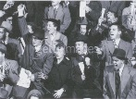
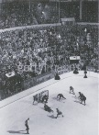
The Hy Peskin photos that didn’t get into the book.

Slide 10
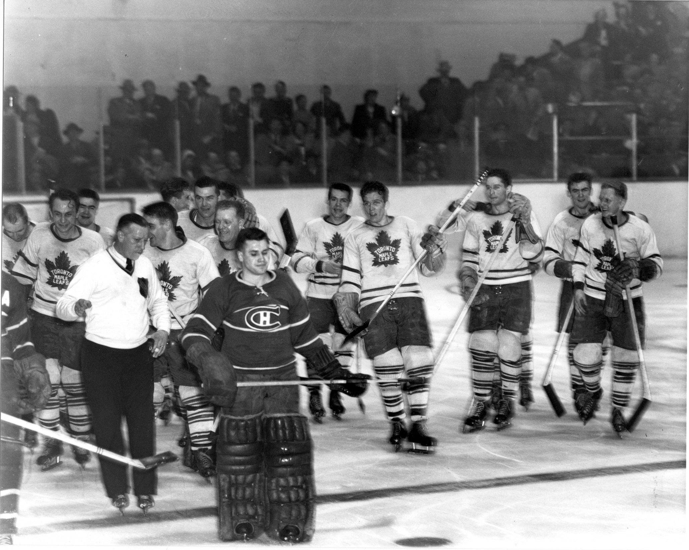
Suffering the agony of defeat, alone.

Slide 11
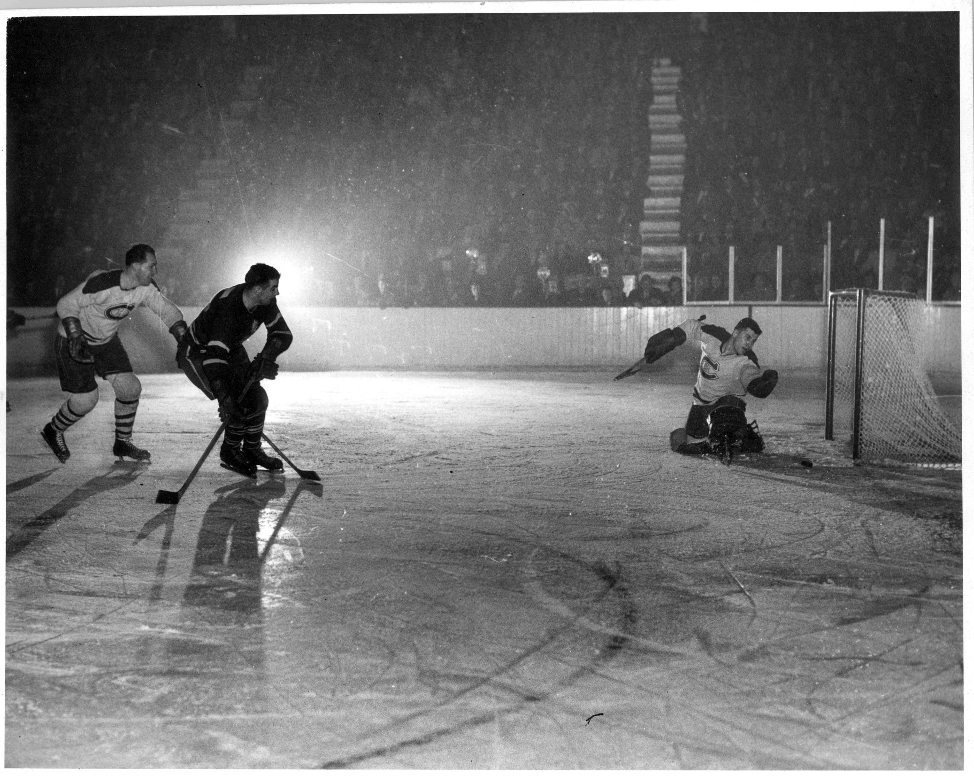
A halo and a hope.

Slide 12
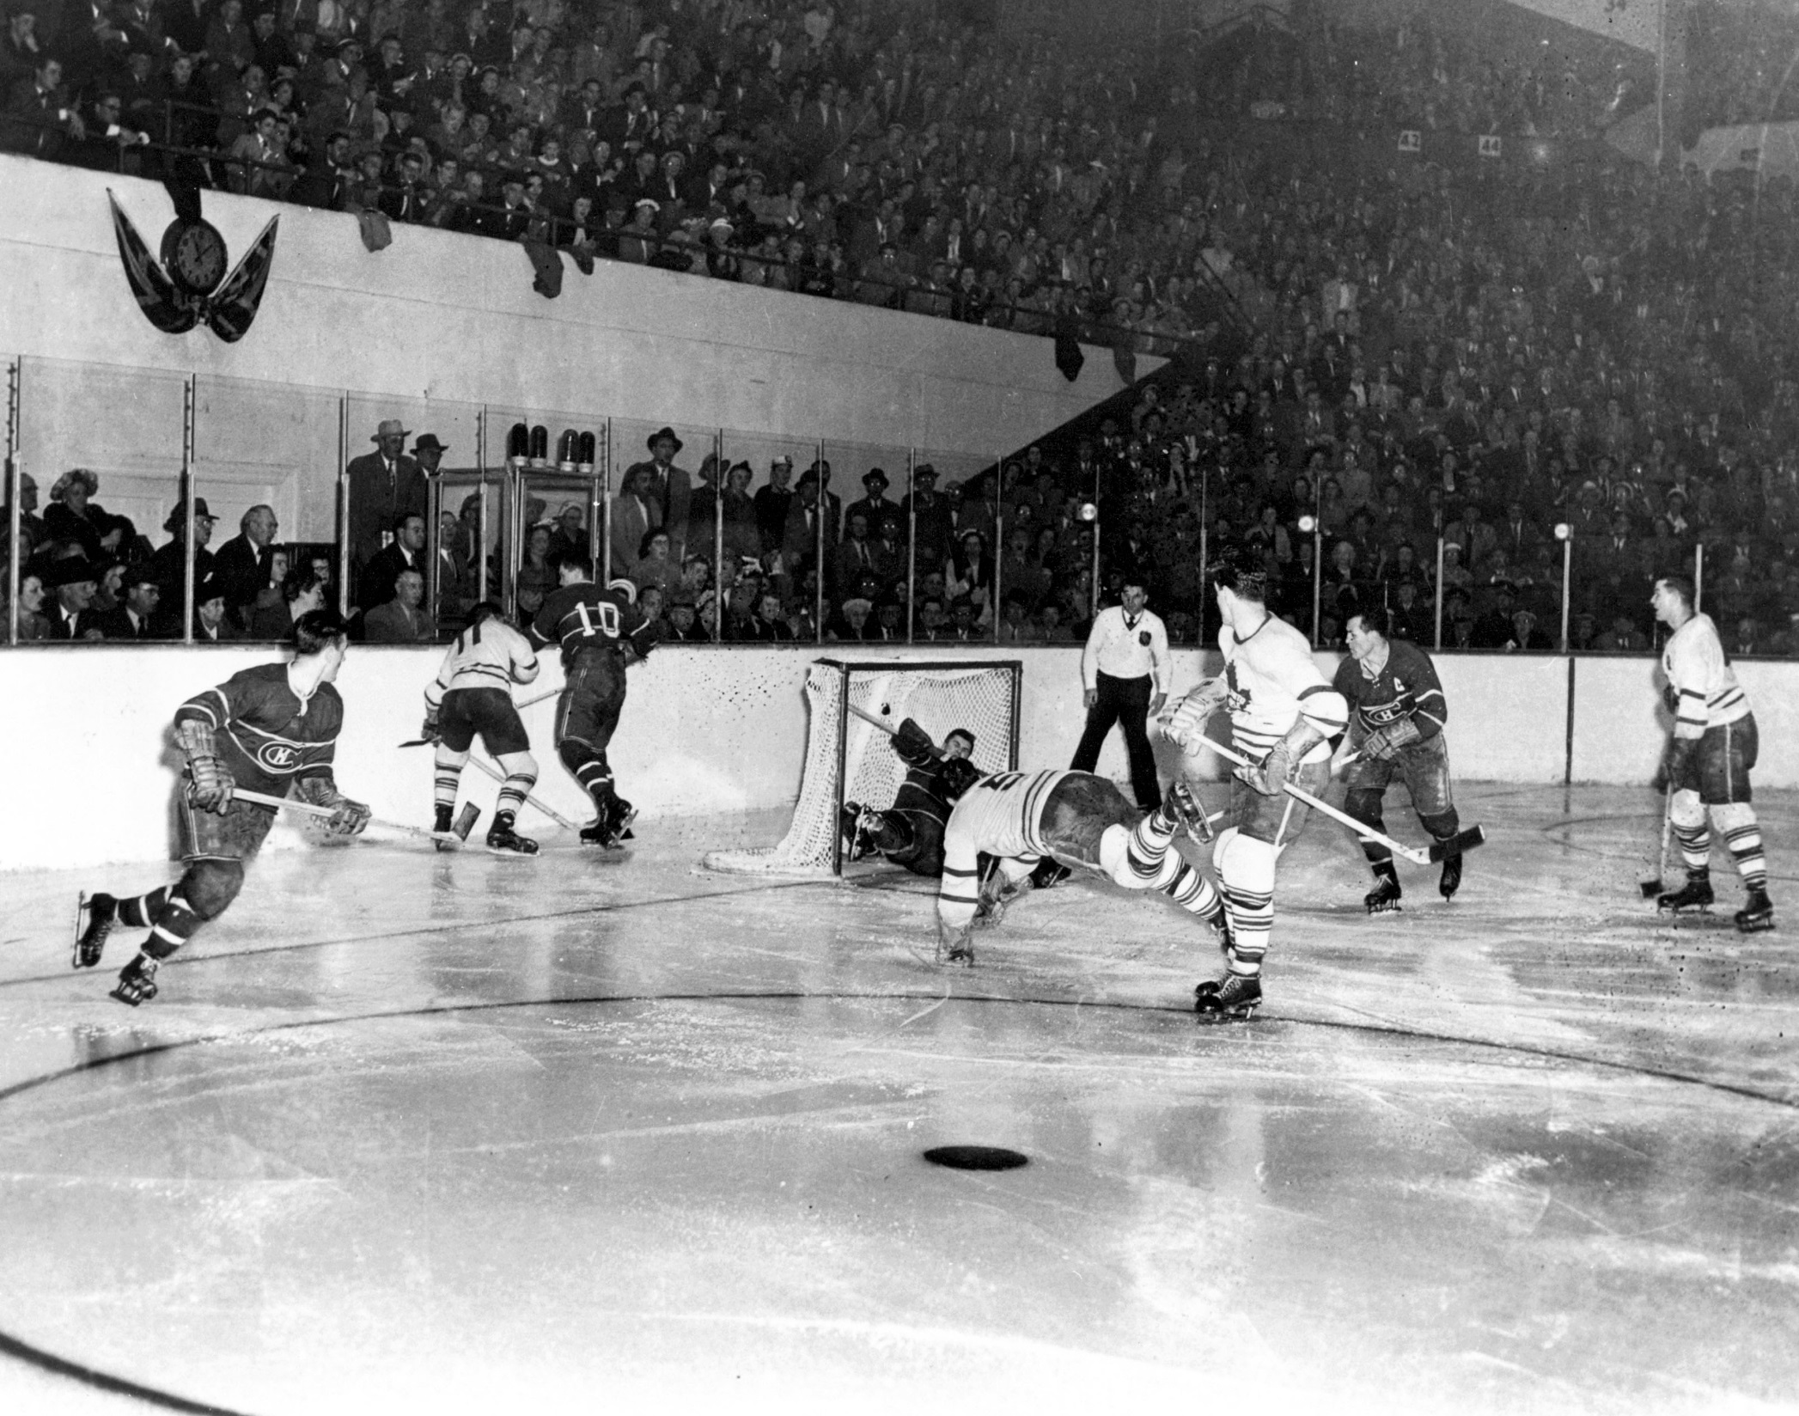
The shot that launched a thousand comments.

Slide 13
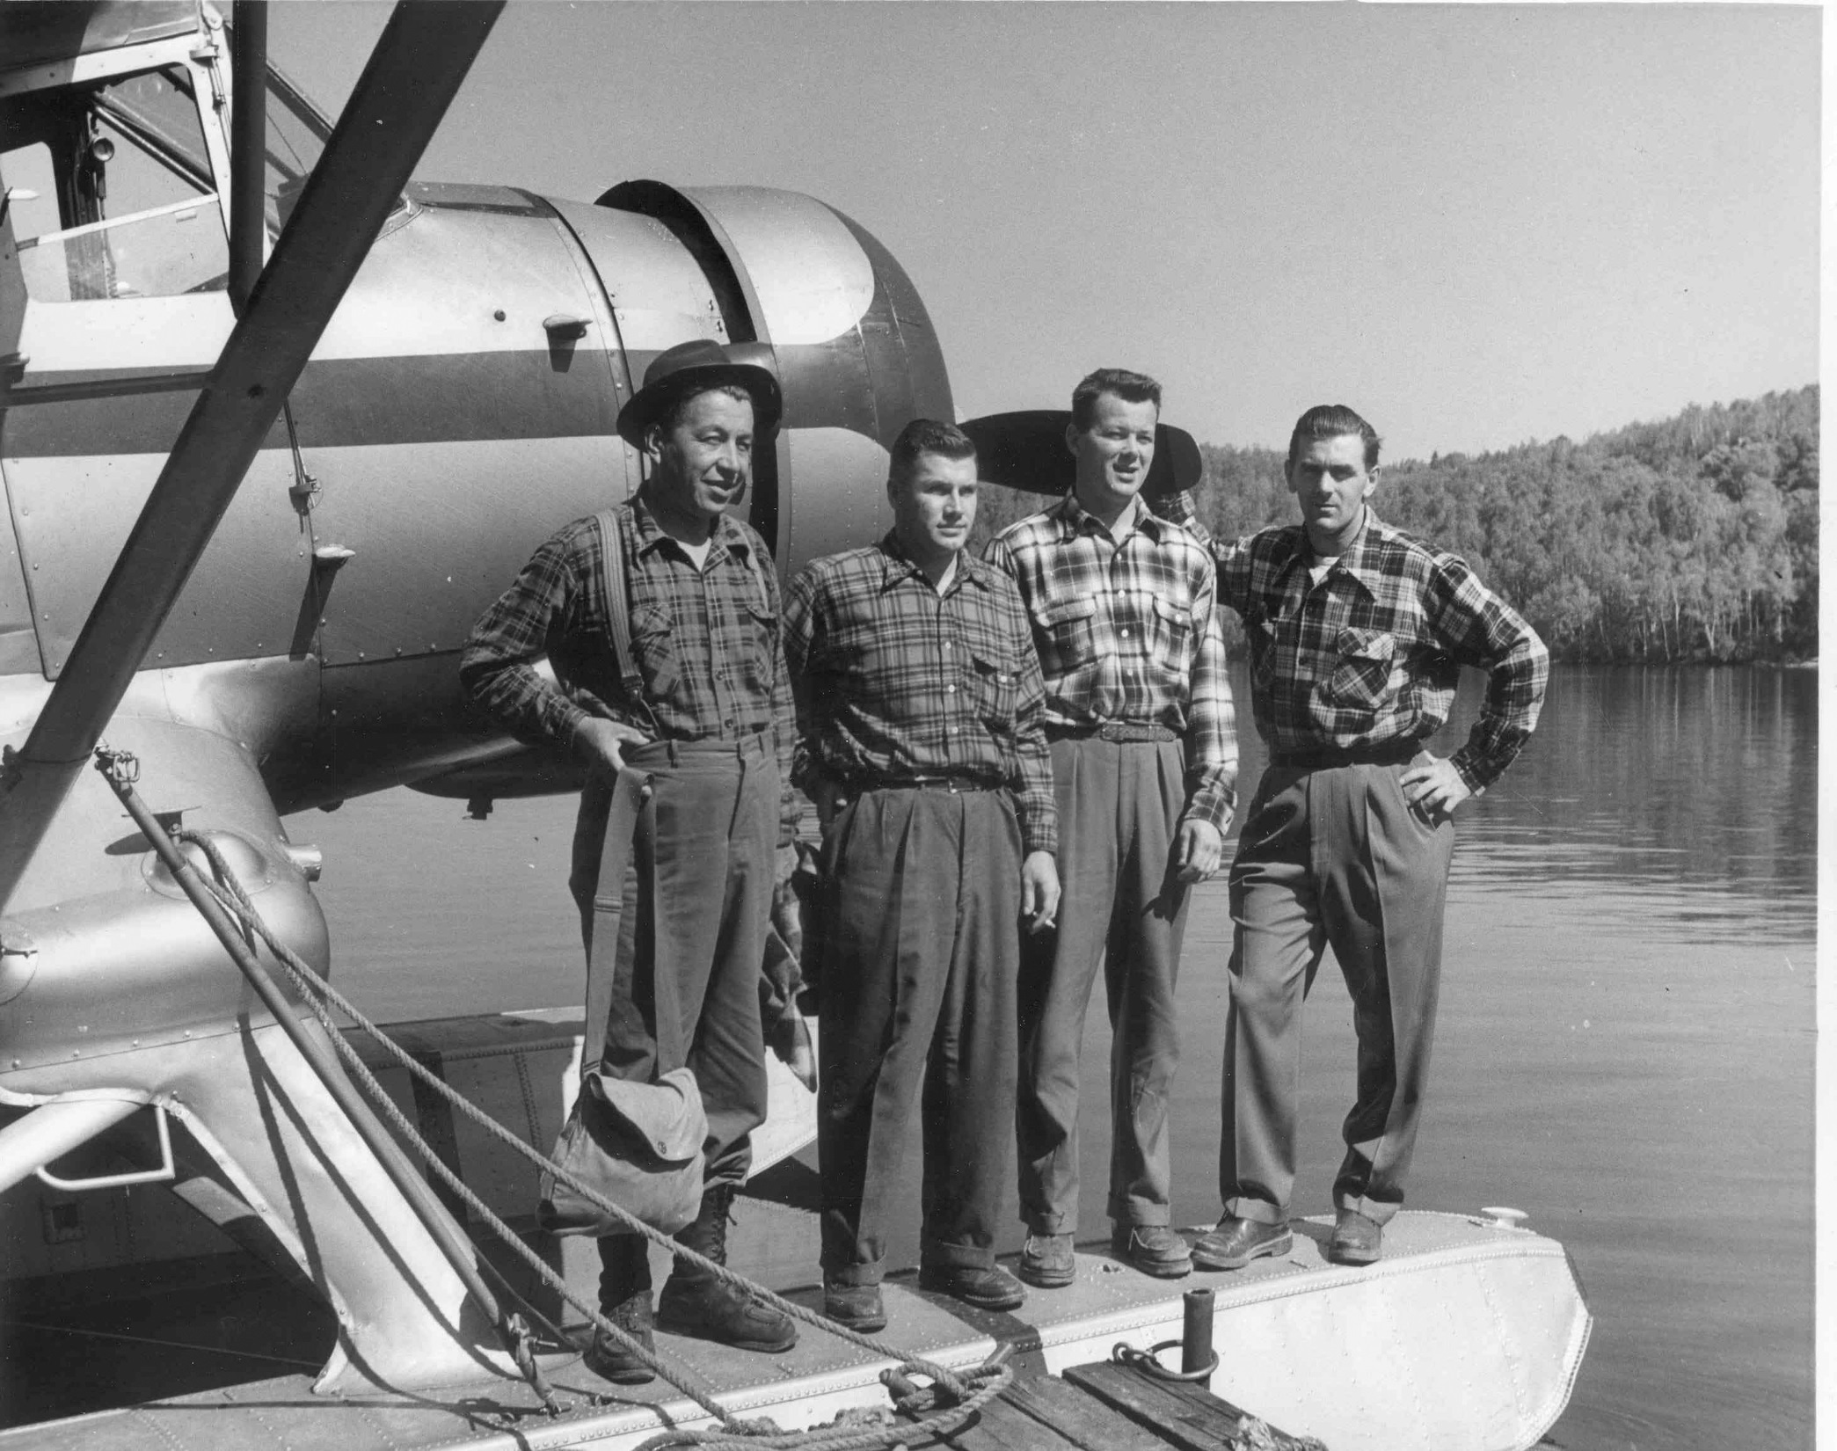
A fishing trip that did not go well.

Slide 14
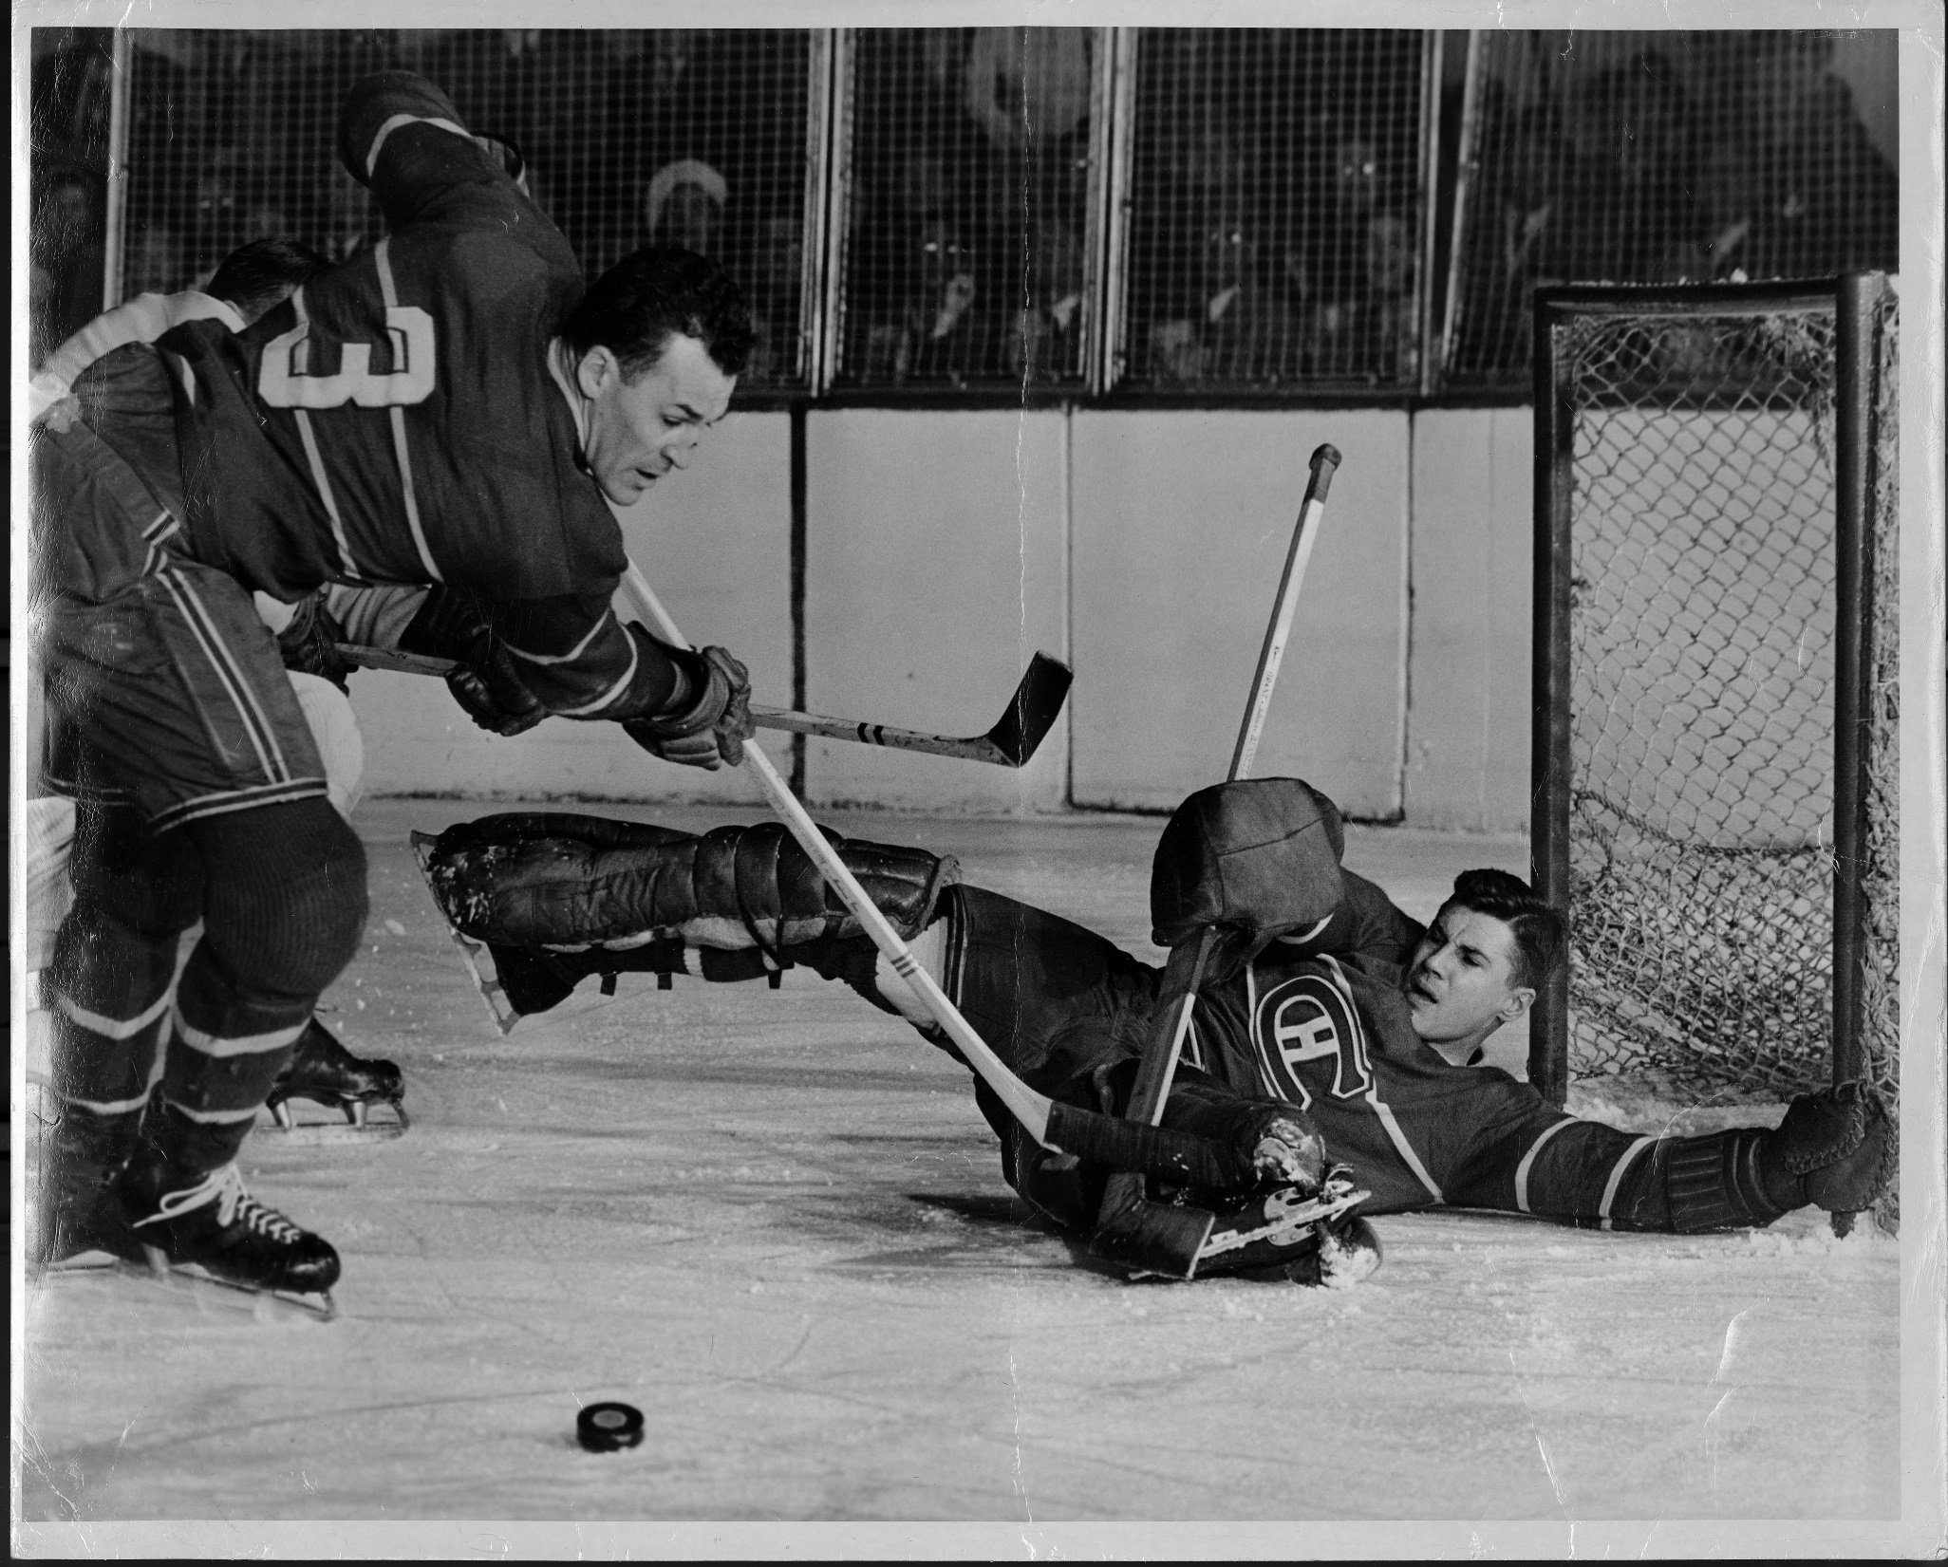
Before the mask. A photo retrieved from oblivion.

Slide 15
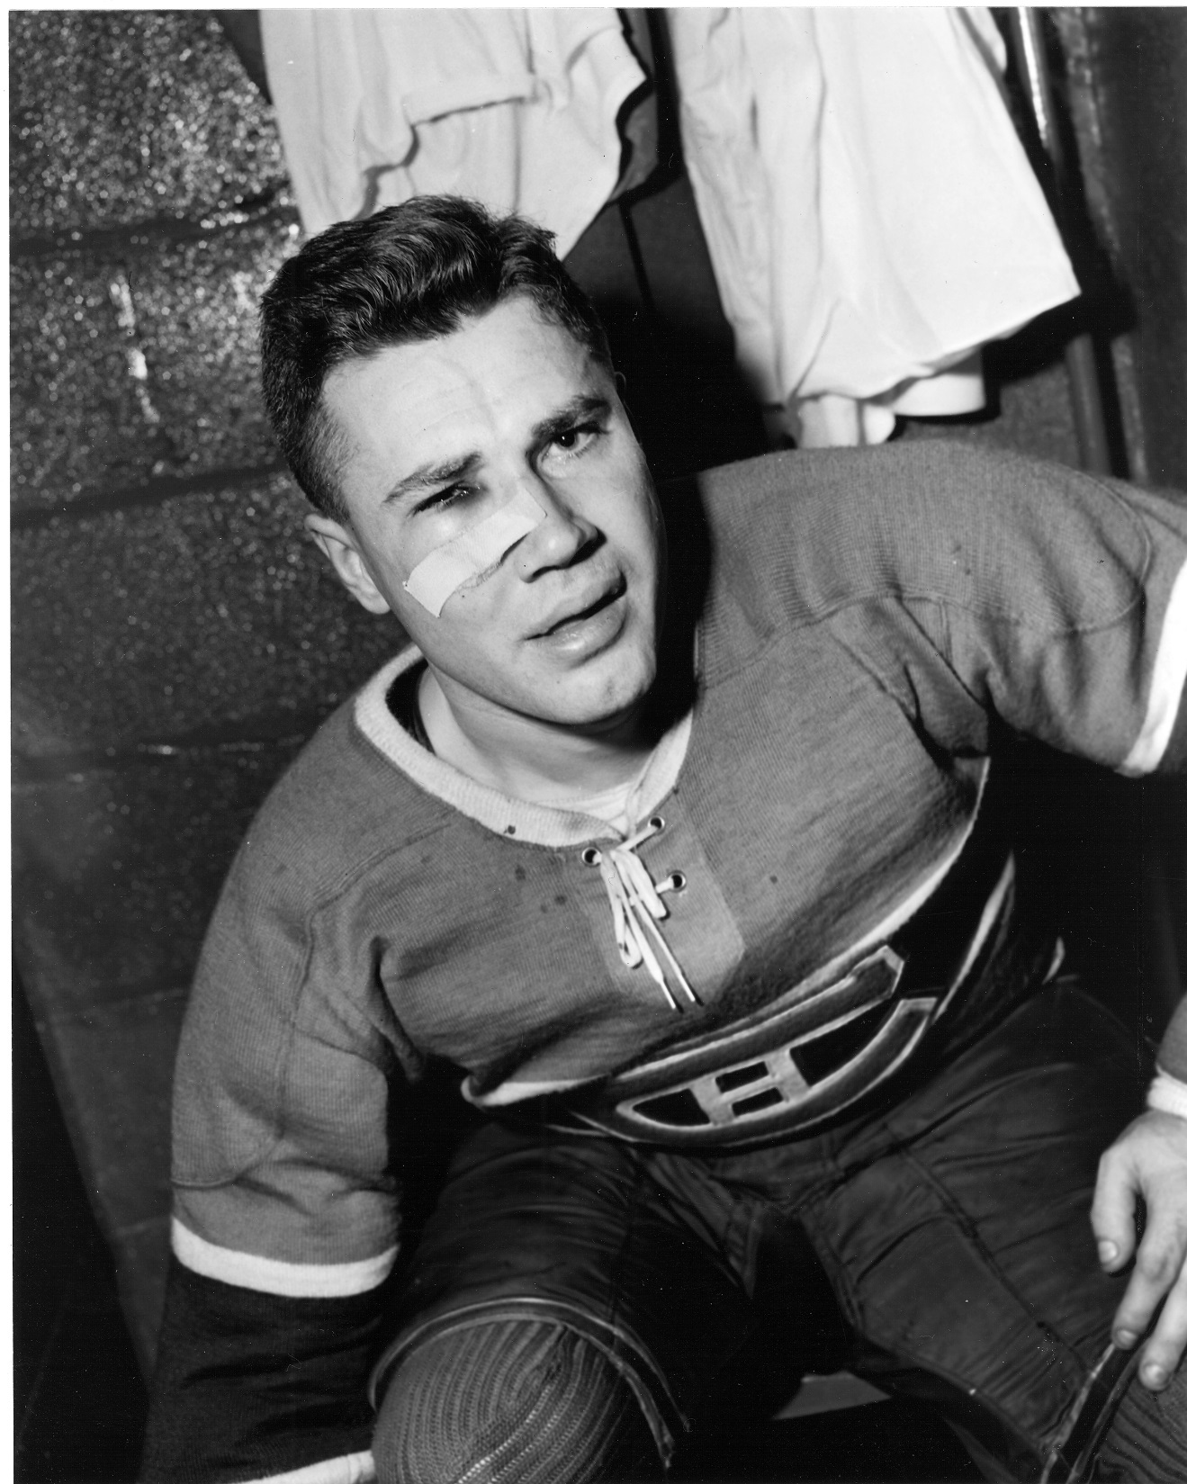
Dick Irvin Sr: I wouldn’t have left him in if I knew he couldn’t see.
Maurice Richard: Just look at his face—anybody can tell he can’t see!!

Slide 16
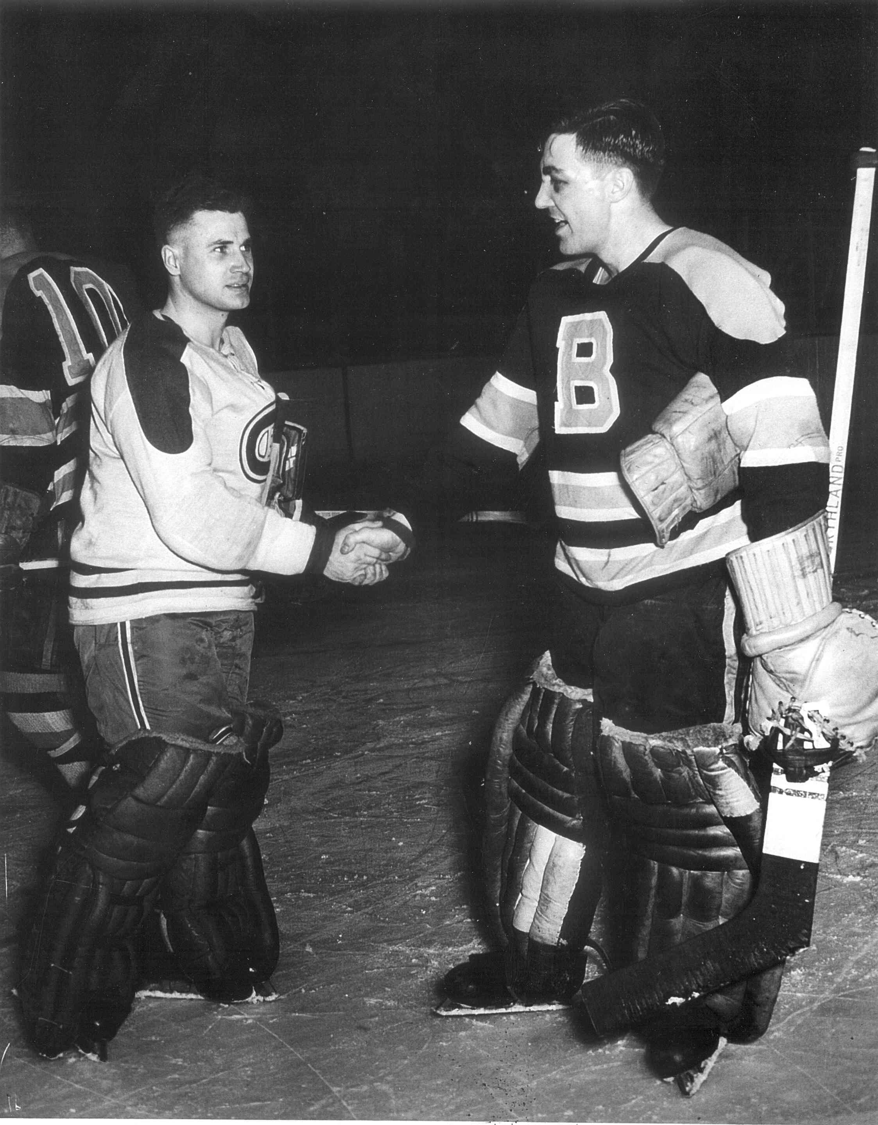
The picture of mutual respect.

Slide 17
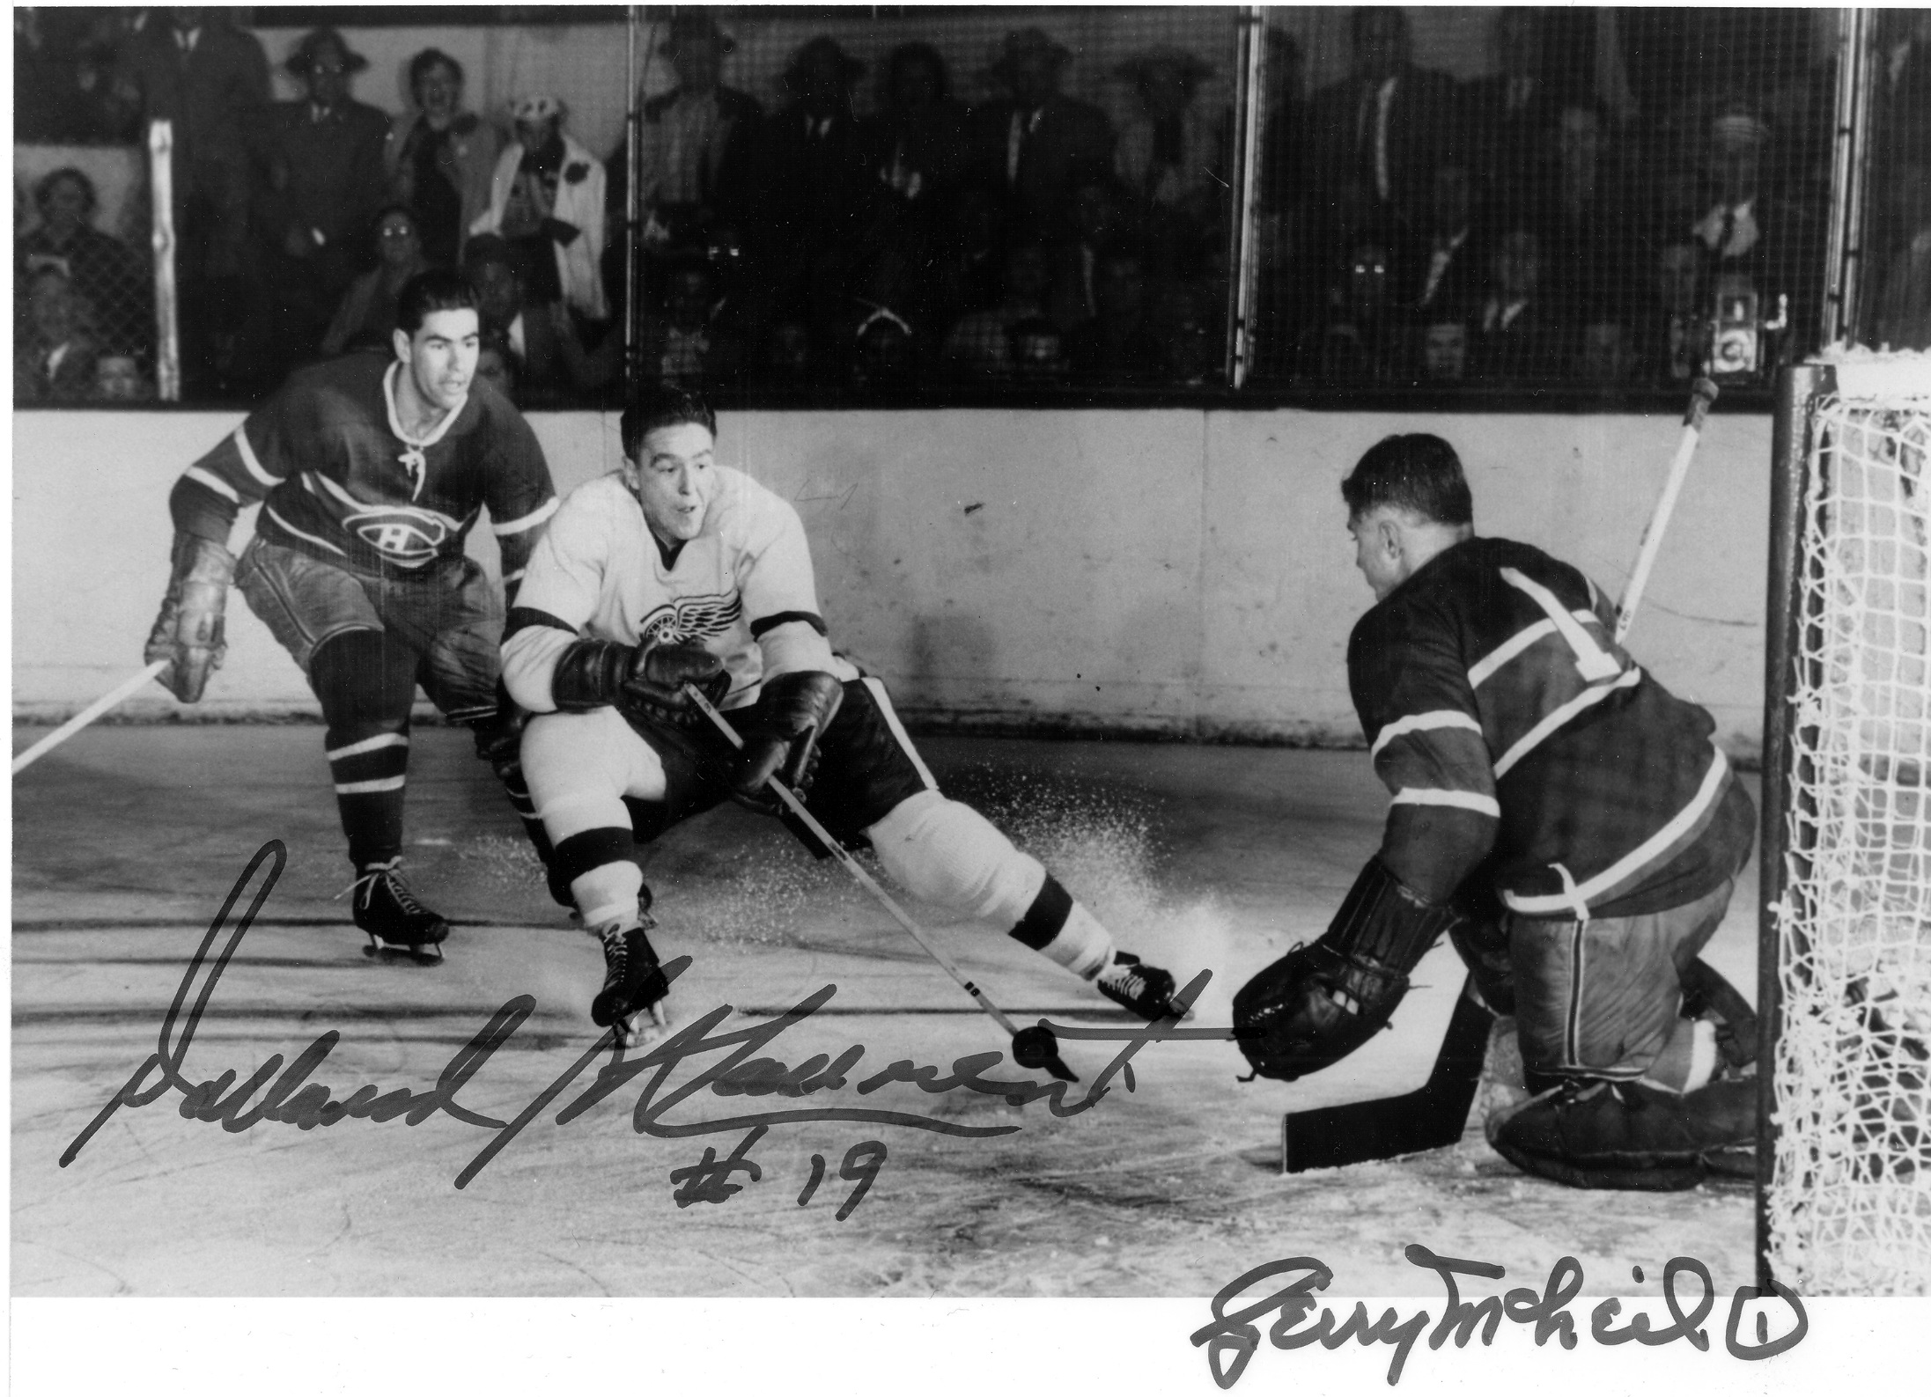
Game Seven.

Slide 18
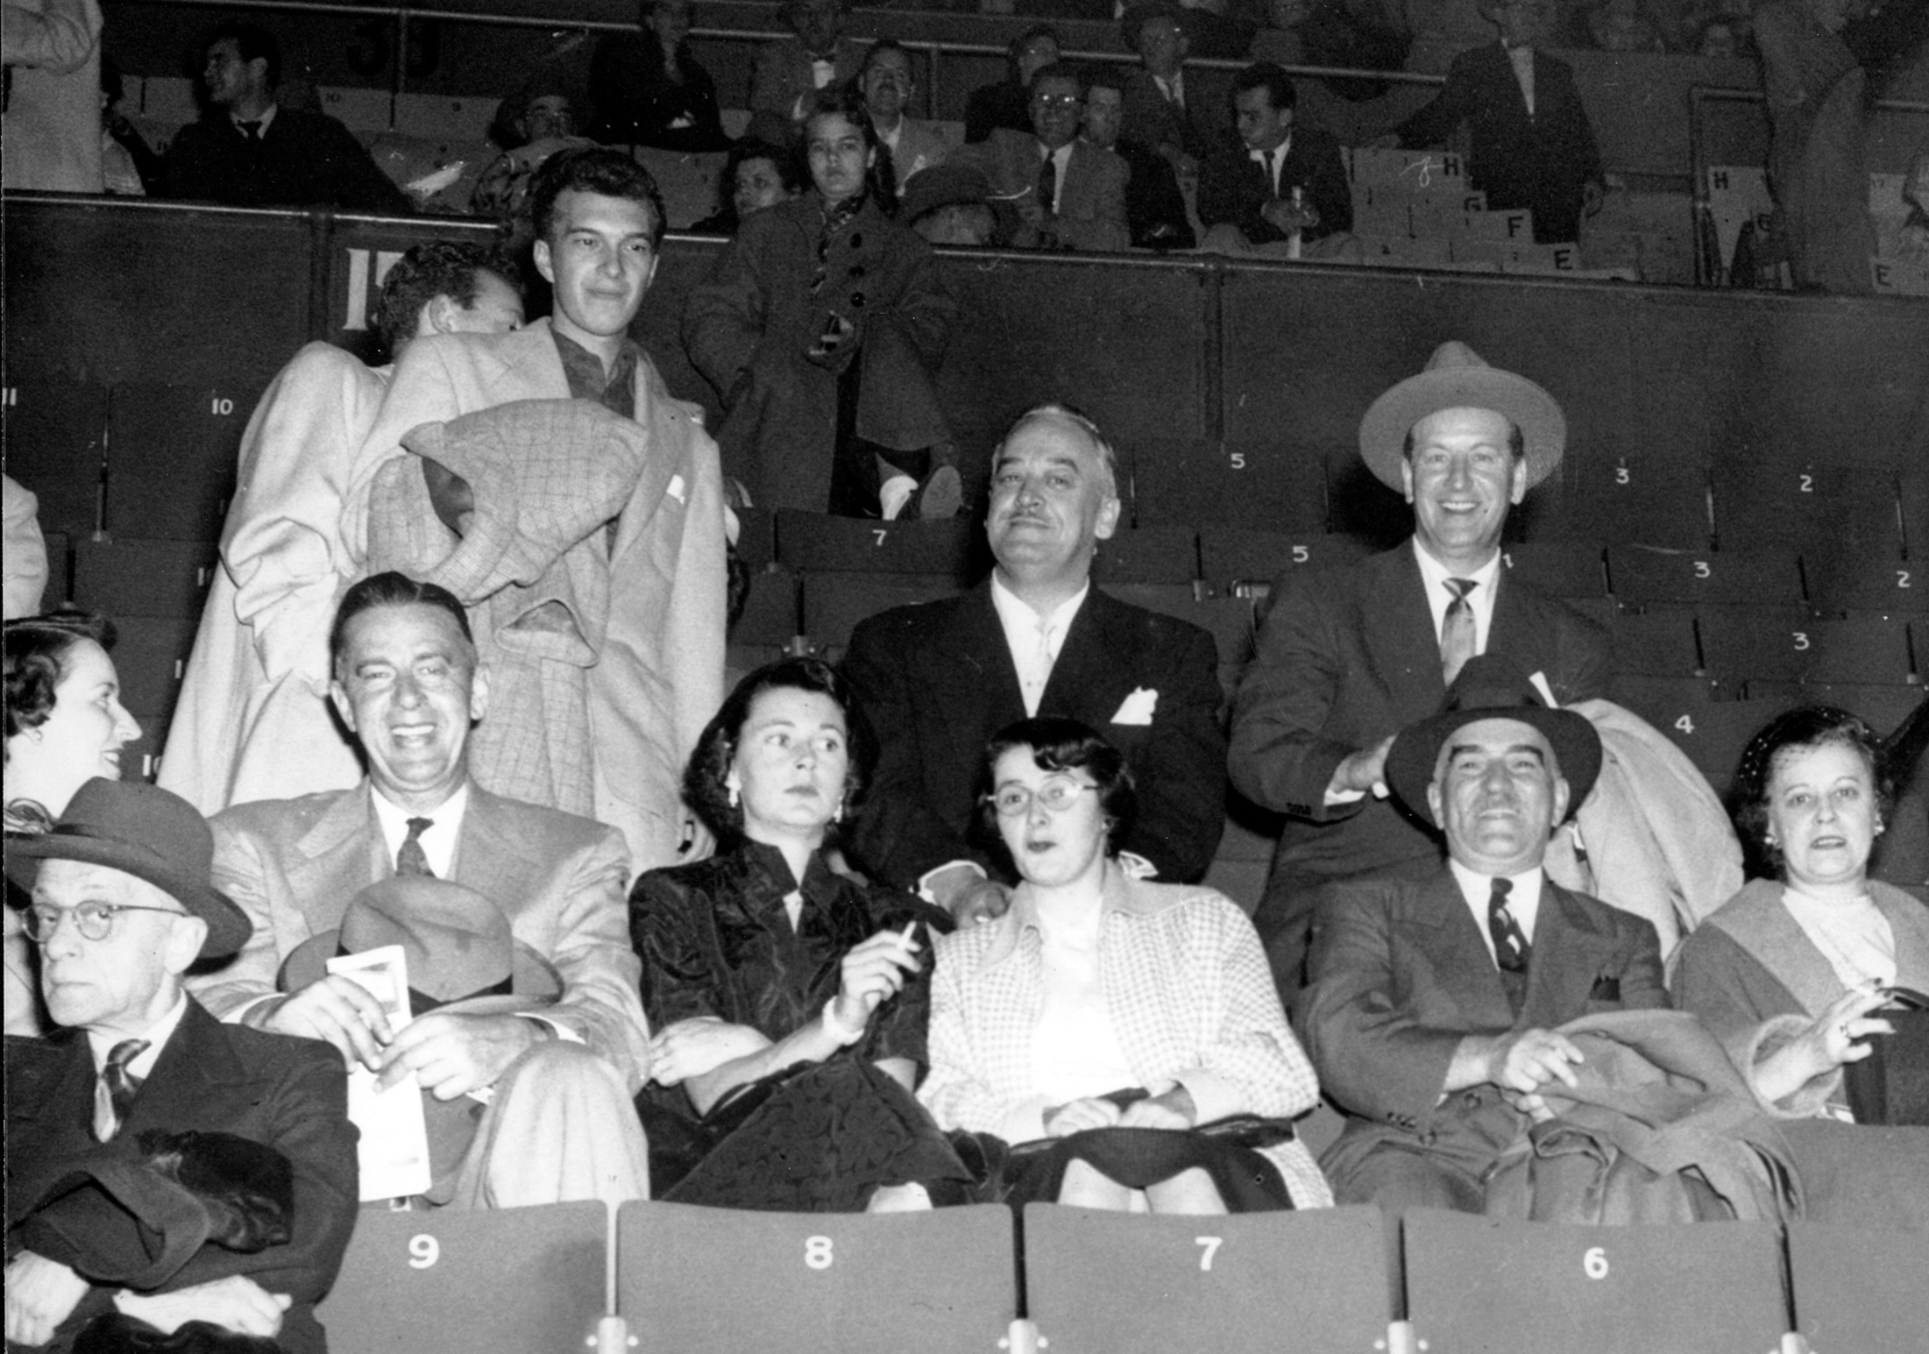
The game may be over, but Theresa still looks as though she is about to be executed.

Slide 19
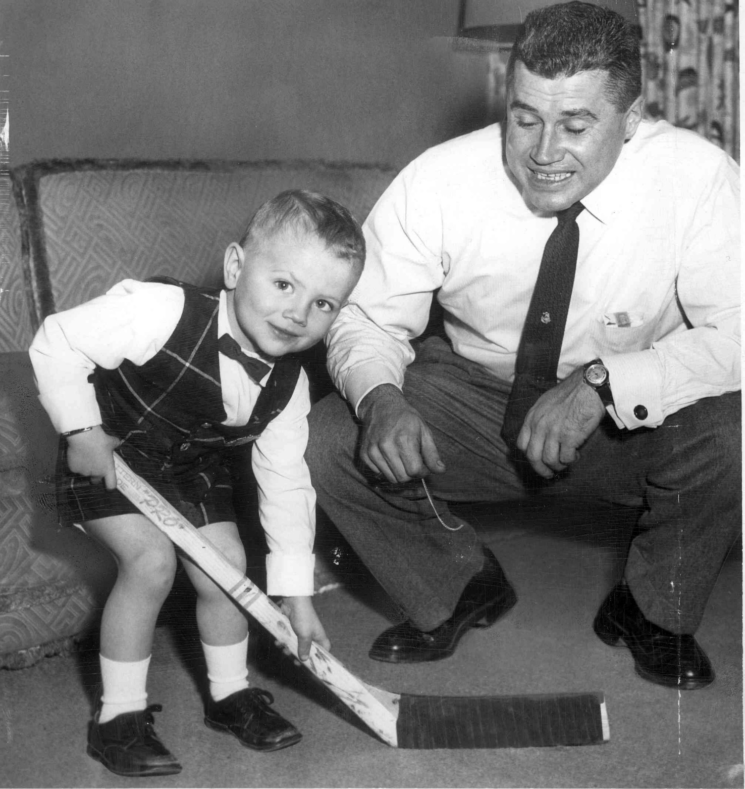
Doing my best for the photographer.

Slide 20
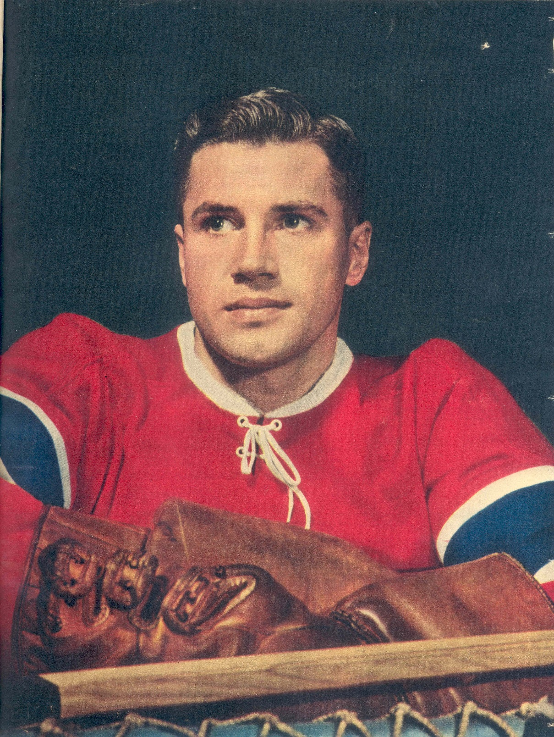
My father’s last words to me.
Thanks for coming

